Slide 1
ORGANISATIONAL
BEHAVIOUR
CHAPTER-8
ATTITUDES AND VALUES

Slide 2
LEARNING OBJECTIVES
1. Attitudes refer to beliefs, feelings and action tendencies of an individual or group of individuals towards objects, people and ideas.
2. Attitudes comprise three variables - affective, behaviour and cognition.
3. Attitudes are formed from several sources.
4. Attitudes, after being formed, discharge several functions.
5. It is difficult to change attitude.
6. Attitude needs to be changed at the individual and group levels.
7. Job satisfaction and organizational commitment are the two types of attitude.
8. Values distinguish between what is right or wrong, good or bad.
9. Attitudes and values are important concepts in the study of OB.

Slide 3
Nature of Attitudes
        Attitudes are learned. How attitudes are learned will be explained in the next section in this chapter.
        Attitudes refer to feelings and beliefs of an individual or groups of people.
        These feelings and beliefs define one’s predispositions towards given aspects of the world.
        Attitudes endure, unless something happens. For example if X is transferred to day shift, his attitude may become positive.
        Attitudes can fall anywhere along a continuum for very favorable to very unfavorable. Such expressions as “This B-School is good”, “This leader is corrupt and incompetent” are heard from people.
        Attitudes are organized and are core to an individual.
        All people, irrespective of their status or intelligence, hold attitudes.

Slide 4
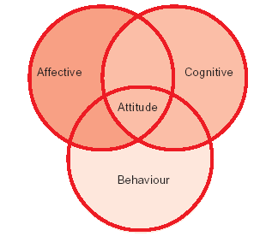
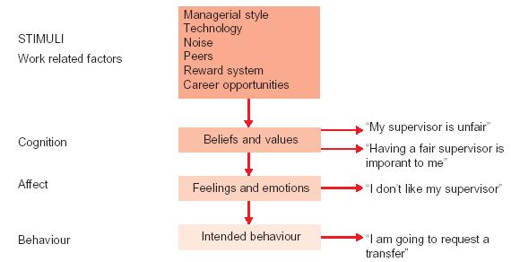
Three Components of Attitudes
Work Related Components of
Attitudes

Slide 5
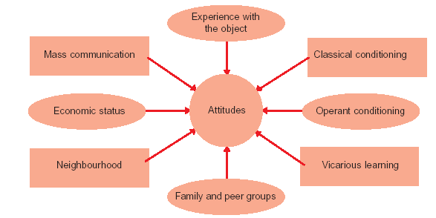
Formation of Attitudes

Slide 6
Benefits of Positive Attitudes
Increases productivity
Fosters teamwork
Solves problems
Improves quality
Makes for congenial atmosphere
Breeds loyalty
Increases profits
Fosters better relationships with employees, employers and customers
Reduces stress
Makes for a pleasing personality.
Functions of Attitudes

Slide 7
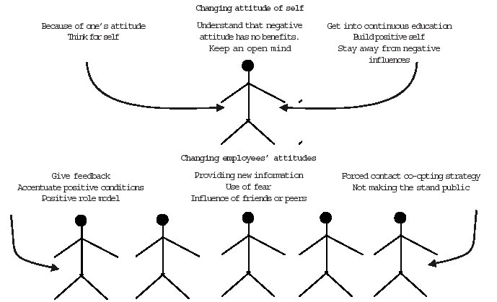
Changing attitudes

Slide 8
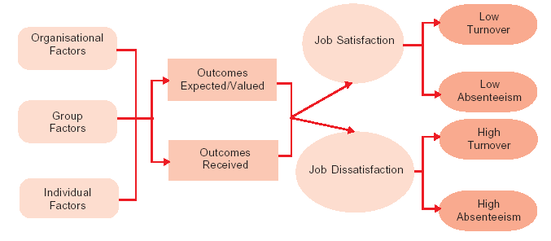
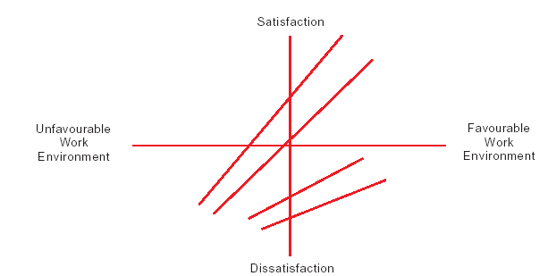
Job Satisfaction
Model
Work Environment
And Job
Satisfaction
Some Possible
Relationship

Slide 9
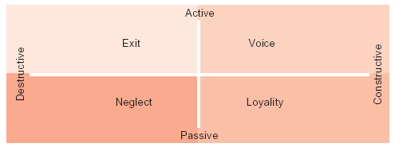
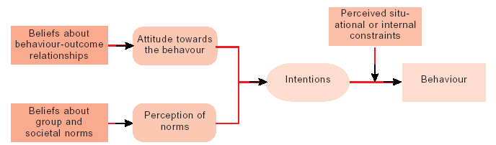
Responses to Job
Dissatisfaction
Behavioural Intentions Model

Slide 10
Summary
        Attitude is an important variable in individual behaviour. Attitude refers to beliefs, feelings and behavioural tendencies of people towards objects, people and ideas. ABC model seeks to better explain the nature of attitude. A stands for affective-feelings; B stands for behaviour – action tendencies; and C stands for cognition- beliefs and opinion.
        Attitudes are formed by direct experience with the object, classical conditioning, operant conditioning, vicarious learning, family and peer groups, neighbourhood and mass communication.
        Positive attitude insures such benefits to the organization as increased productivity, better quality, reduced stress, improved loyalty and the like.
        Attitude serves important functions such as adjustment, ego-defense, value expressive and knowledge.
        Attitudes of individuals and groups need to be changed. But change is difficult because of three barriers - escalation of commitment, cognitive dissonance, and insufficient information.
        There are hints available to change attitudes both at the individual and group levels.
        Job satisfaction is one type of attitude. It refers to the general attitude of employees towards their jobs. Job satisfaction is the cause for several benefits and consequence of many factors. It is useful to measure job satisfaction and OB experts have suggested several techniques for measuring.
        Another work related attitude is organizational commitment. Organizational commitment refers to the strength of an employee’s involvement in the organization and identification with it.
        Organizational commitment varies across countries, Asian countries score high on this variable.
        Values represent stable, long-lasting beliefs about what is important. There are personal as well as organizational values. An individual enters organization with his or her values which often clash with organizational values. They need to be merged for increased organizational effectiveness.
        Attitude is an important concept in the study of OB as it has influence on perception, satisfaction and commitment.
        Values influence attitudes, motivation and perception.

Slide 11
Key Terms
Attitude
ABC model
Cognitive dissonance
Organizational commitment
Value
Escalation of commitment
Job satisfaction
Behaviour Intentions Model

